Slide 1


Rockbuster Stealth LLC Marketing Transition Analysis

Slide 2

Rockbuster Stealth LLC
Rockbuster Stealth LLC is a movie rental company that used to have stores around the world. Facing stiff competition from streaming services such as Netflix and Amazon Prime, the Rockbuster Stealth management team is planning to use its existing movie licenses to launch an online video rental service in order to stay competitive.

Slide 3
Questions and Objectives
Which movies contributed the most/least to revenue gain?
What was the average rental duration for all videos?
Which countries are Rockbuster customers based in?
Where are customers with a high lifetime value based?
Do sales figures vary between geographic regions?

Slide 4
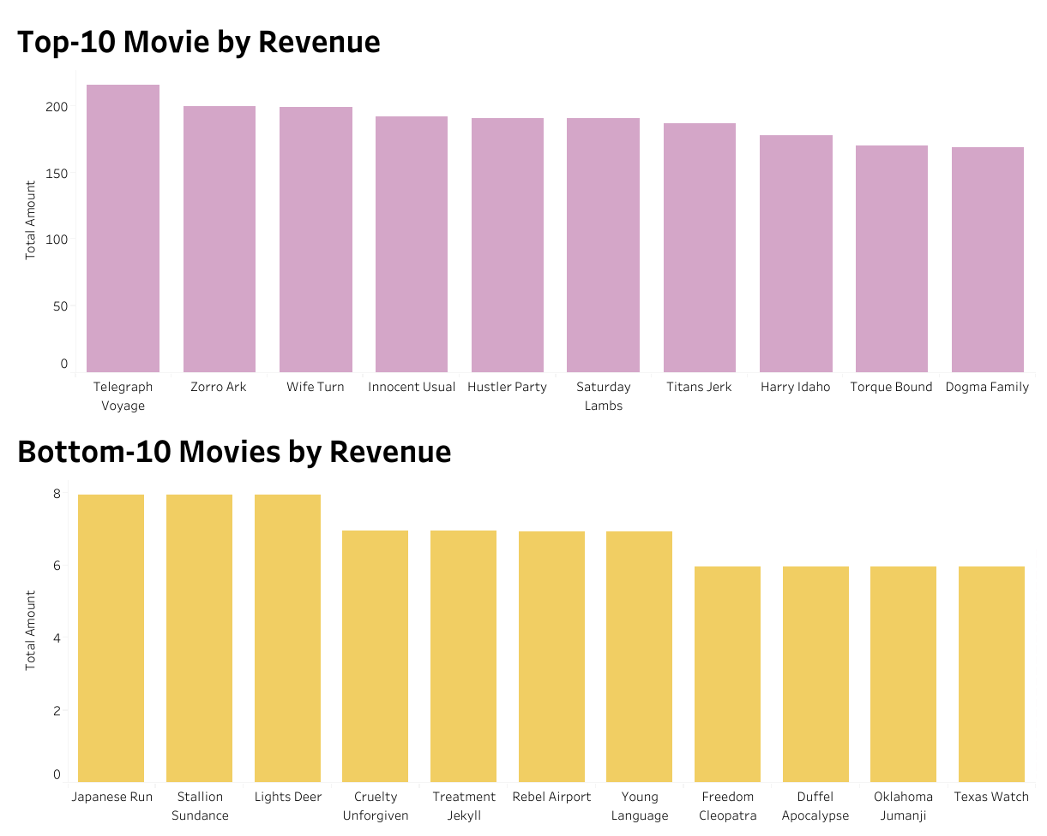
Movie Revenues
The most popular film, Telegraph Voyage, generated 40 times more revenue than the least popular films.

Slide 5
Descriptive Statistics of Data
The dataset includes 599 customers from 600 cities across 109 countries. It contains 1,000 films spanning 20 genres, generating a total revenue of $61,312.04.
 | Average | Maximum | Minimum
Rental Duration (Day) | 5 | 7 | 3
Rental Rate ($) | 3 | 5 | 1
Length(Min) | 115 | 185 | 46
Replacement Cost ($) | 10 | 30 | 20

Slide 6
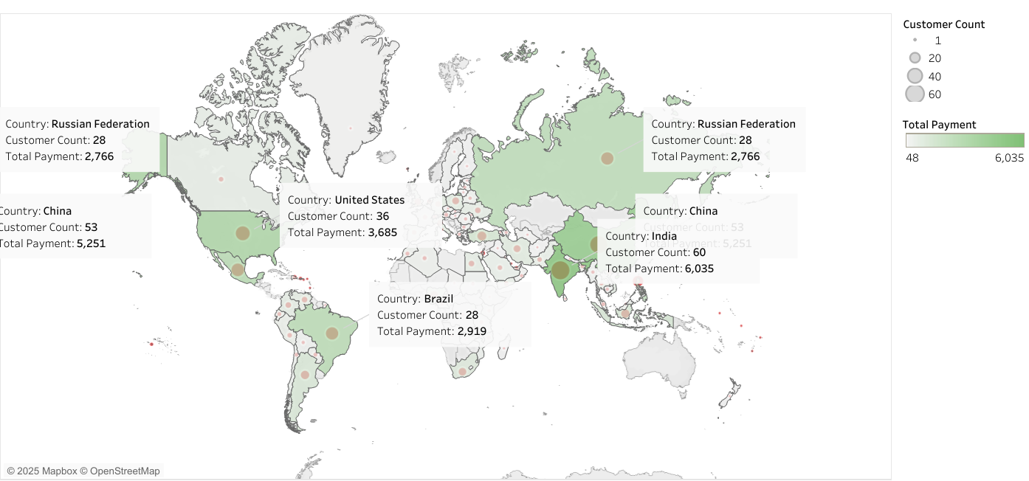
Location of Customers
India and China had the largest customer bases, followed by the United States, Japan, Mexico, Brazil, Russia, the Philippines, and Turkey.

Slide 7
High Lifetime-Value Customers
Name | Country | City | Total Amount
Sara Perry | Mexico | Atlixco | 128.7
Gabriel Harder | Turkey | Sivas | 108.75
Sergio Stanfield | Mexico | Celaya | 102.76
Clinton Buford | United States | Aurora | 98.76
Adam Gooch | India | Adoni | 97.8

Slide 8
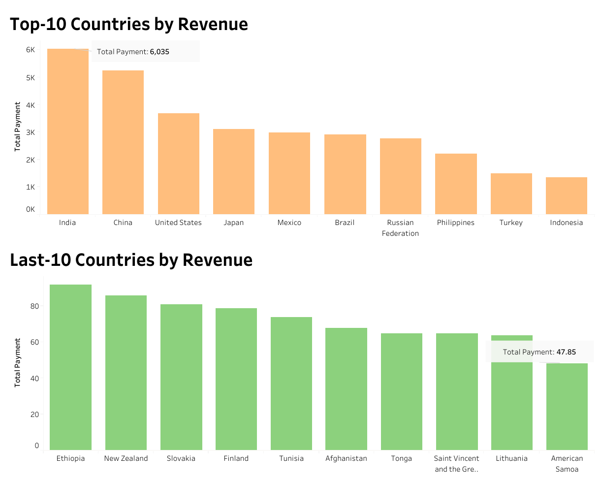
Country Revenues
India generated the highest revenues, producing 150 times more than American Samoa, which recorded the lowest revenues.

Slide 9
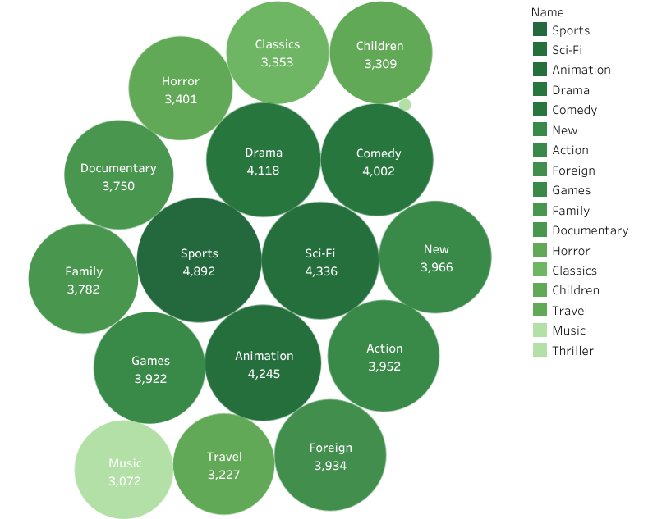
Revenue by Genre
Globally, the Sports, Sci-Fi, and Animation genres were the most profitable, whereas Children, Music, and Thriller generated the lowest revenues.

Slide 10
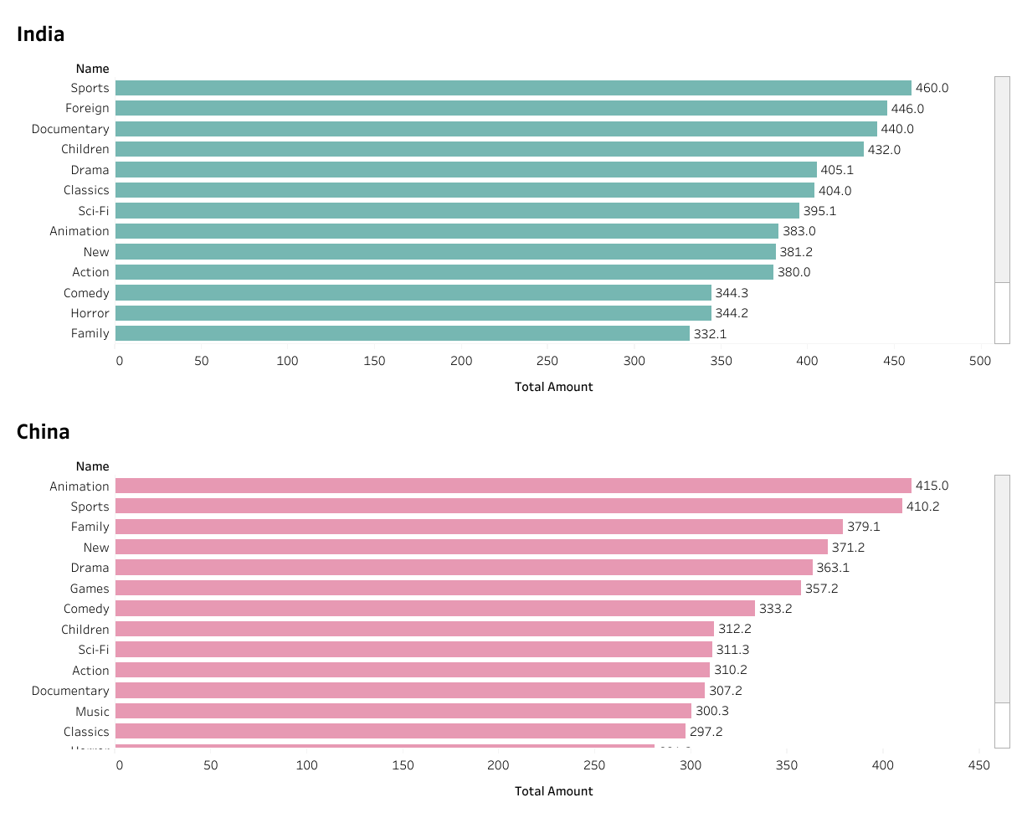
India VS China Revenue by Genre
In India, the Documentary and Children genres attracted 440.0 and 432.0, respectively, while in China they generated only 307.2 and 312.2. In contrast, the Family genre performed better in China with 379.1, compared to just 332.1 in India.

Slide 11

Conclusions and Recommendations
Findings
India and China dominate the customer base and revenue, with India generating the most.
Sports, Sci-Fi, and Animation are the top-earning genres, while Children, Music, and Thriller underperform.
Regional differences matter: India favours Documentary/Children, while China favours Family
Recommendations
Focus on India & China with tailored content and localized marketing.
Prioritize high-performing genres (Sports, Sci-Fi, Animation) to drive revenue.
Reassess low-performing genres and adapt strategies by region.

Slide 12
Thank you! 😊

